Slide 1
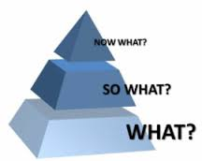
What is Philanthropy and how it is important in current world
By Bekay Ahn, CFRE
www.icnpm.org
cfretrainer@gmail.com

Slide 2
Philanthropy
개인
Individualism
공익
Common Goods
자원봉사
Volunteerism
다원성
Pluralism
혁신성
Innovation

Slide 3
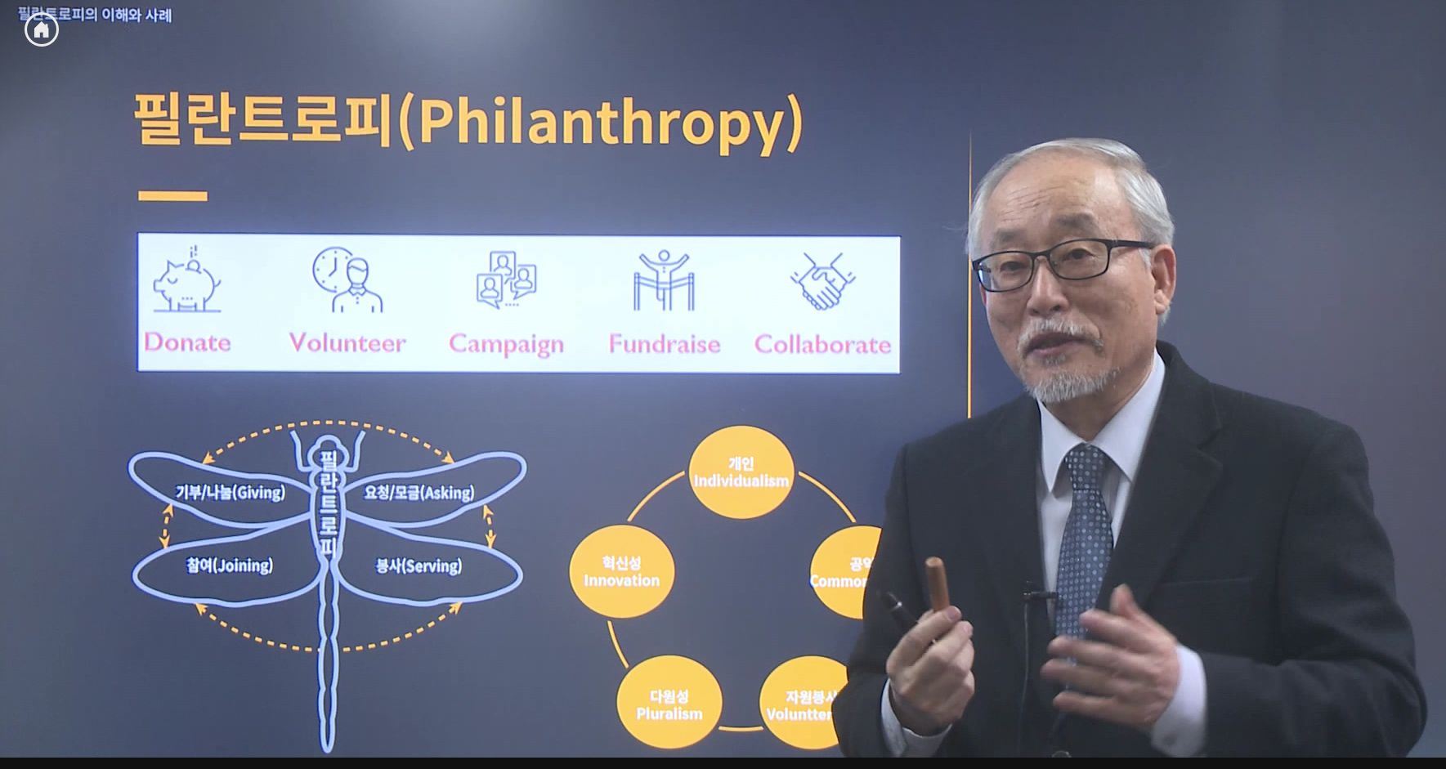

Slide 4
4 Elements of Philanthropy
Relief
Alleviate human suffering
Principle of compassion
Improvement
maximizes
human potential
Principle of Progress
Social Reform
Solves social problems
Principle of Justice
Civic Engagement
Builds community
Principle of participation

Slide 5
Philanthropy, Business & Government
Philanthropy
Government
Business
Business-Government Gear
Co-dependent relationship
A balanced relationship is required for the stability and welfare of the economy and nation
Example: Tax credits and subsidies for small, medium enterprises.
Philanthropy-Government Gear
Example: Affordable housing in the United States. Nonprofits are the primary producers of affordable housing for low and moderate income families.
Philanthropy supports the administrative cost of the nonprofit, as well as development costs, which reduces what a family will need to pay. Government provides the lion’s share of funding for the actual construction and maintenance
Philanthropy-Business Gear
“Philanthrocapitalism”
Example: Facebook CEO Mark Zukerberg announced in 2015 that he and his wife is committed, over the course of their lives, to donate 99% of their shares in Facebook (at that time valued at US$45bn) to the “mission” of “advancing human potential and promoting equality” via the Chan-Zukerberg Initiative.
Philanthropy-Business-Government System
When all three gears (Business gear, Government gear, and Philanthropy gear) are engaged, it creates an efficient, integrated and powerful system that works best for the society.
Example: Social enterprises that receive funding from Government.

Slide 6
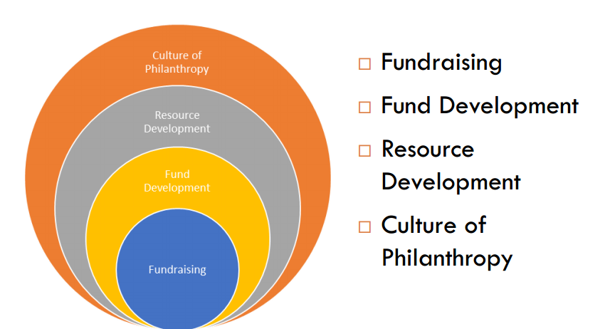
What is Fundraising?

Slide 7
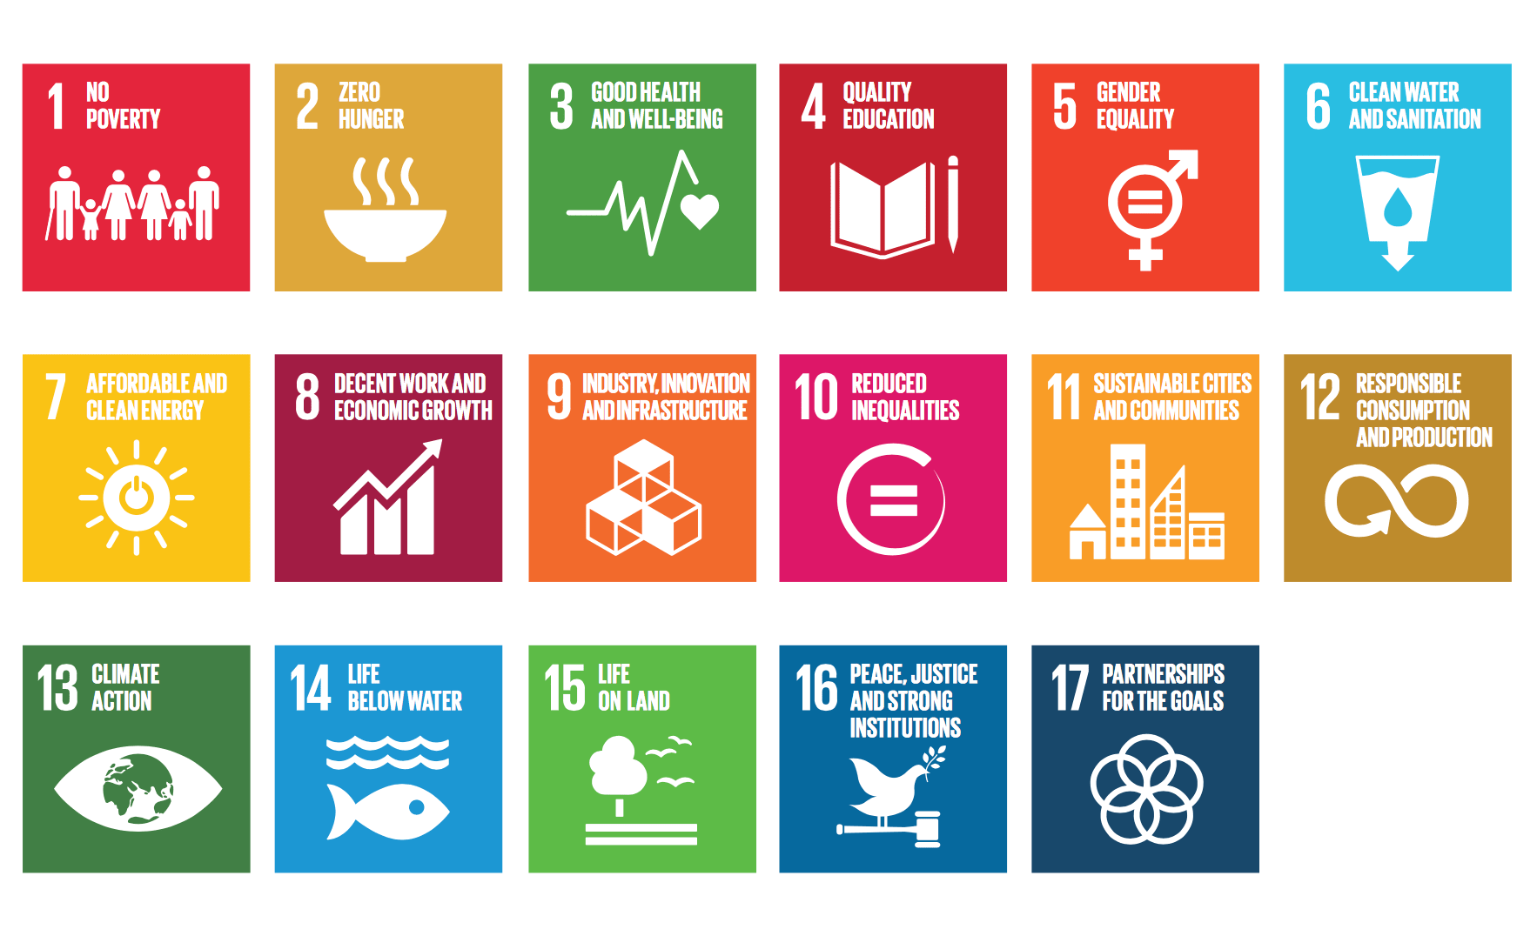
Are you agree with this?
at least three sustainable development goals (SDGs), including ‘ensure healthy lives and wellbeing for all at all ages,’ ‘inclusive and quality education and lifelong learning’ and ‘peace, justice and strong institutions.

Slide 8
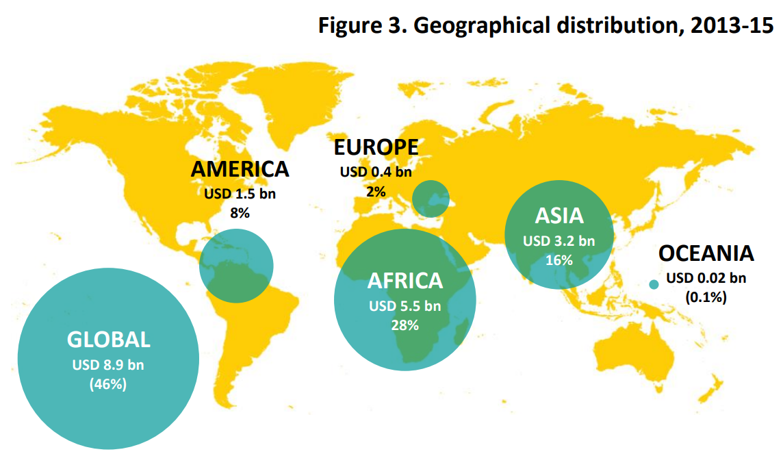
Philanthropy plays significant role in global development

Slide 9
The New Frontiers of Philanthropy Ecosystem
New Frontiers of Philanthropy: By Lester M. Salamom, P7
NEW SOURCES OF FUNDS
Banks
Pension funds
Insurance companies
Quasi-public investment funds
Investment firms
Foundations
HNWIs
ACTORS
Social impact
investment
organizations
Social impact
investment
support
organizations
New
types of
grantmakers
TOOLS
Social impact
investment
tools
Other financial
and non-financial
tools
TARGETS
Nonprofits
Social enterprises
L3Cs
Social cooperatives
Benefit corporations
BENEFICIARIES
Poverty alleviation
Environmental improvement
Strengthened civil society
Improved life chances

Slide 10
Philanthropic Evolution
Charity
Philanthropy
Strategic Philanthropy
Impact Investing
 | Communication | Methods | Goals
Giving 1.0 | One Way, Website | Efficiency and Effective | Total Giving
Giving 2.0 | Two Way, SNS | Transparency and Participation | Improve Giving Culture
Giving 3.0 | Multi Channel, Big Data | Impact | Philanthropy

Slide 11
Giving Trends
Giving a fish
Teach how to catch fish
Let them taste the different fish
Loan the fishing pole
Invest the fish farm

Slide 12
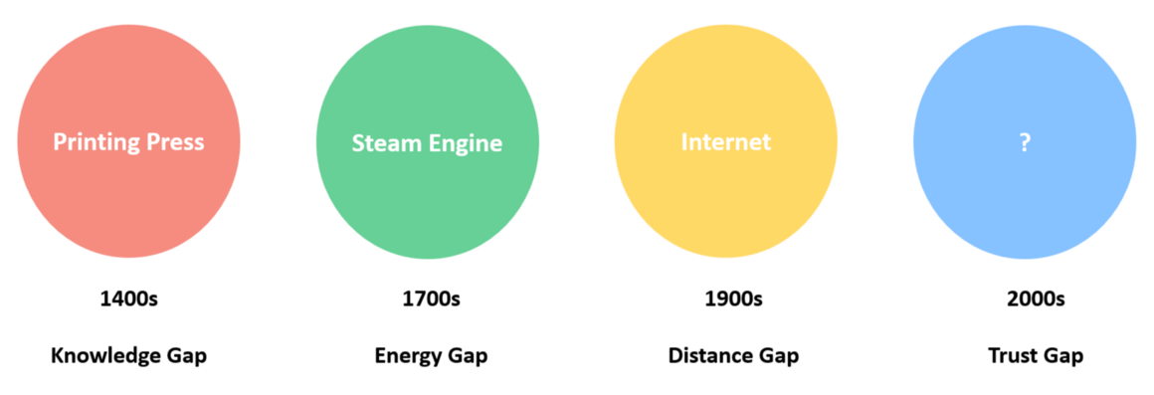
Social Innovation with Technology

Slide 13
The 2018 Global Philanthropy Environment Index
The 2018 Global Philanthropy Environment Index uses regulatory and fiscal indicators, as well as
socio-cultural and political indicators, to provide a comprehensive understanding of the existence of
the conditions required to build and maintain the capacity and propensity of individuals and
organizations to engage in philanthropic activities. The ten indicators have been grouped in five distinct sets of factors according to their nature. Each
indicator matches one specific question in the questionnaire sent to country-level experts to collect
information.
A. Regulations for Philanthropic Organization formation, operation and dissolution
1. Ease of incorporating a philanthropic organization
2. Ease of operating a philanthropic organization
3. Government discretion to shut down a philanthropic organization
B. Laws and regulations governing fiscal incentives and disincentives of giving and
receiving donations domestically
4. Fiscal incentives for individuals making charitable donations domestically
5. Fiscal incentives for organizations receiving domestic donations
C. Laws and regulations governing fiscal incentives and disincentives of giving and
receiving donations across borders
6. Extent to which the legal regulatory environment is favorable to sending
cross-border donations
7. Extent to which the legal regulatory environment is favorable to receiving
cross-border donations
D. Political and governance environment
8. Relations between government and philanthropic organizations
9. Government support of philanthropic giving
E. Socio-Cultural environment
10. Socio-cultural values, beliefs, and practices related to philanthropic
organizations and philanthropic causes

Slide 14
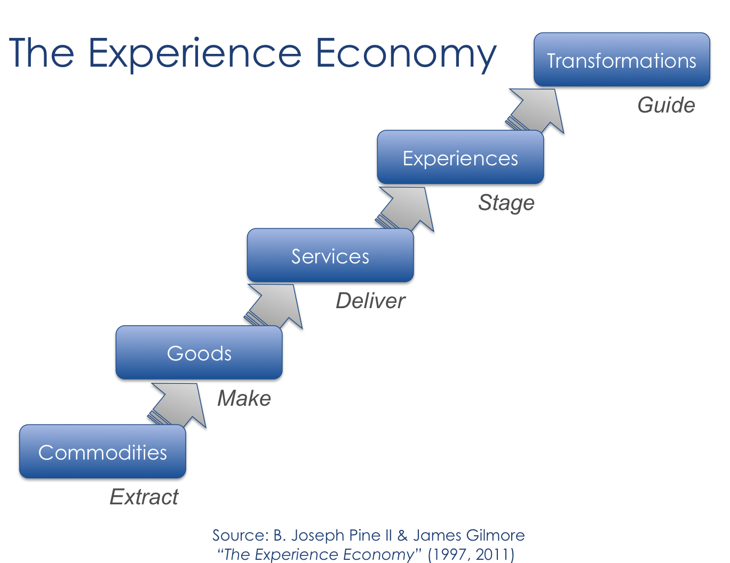
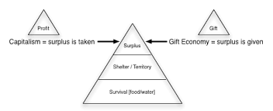
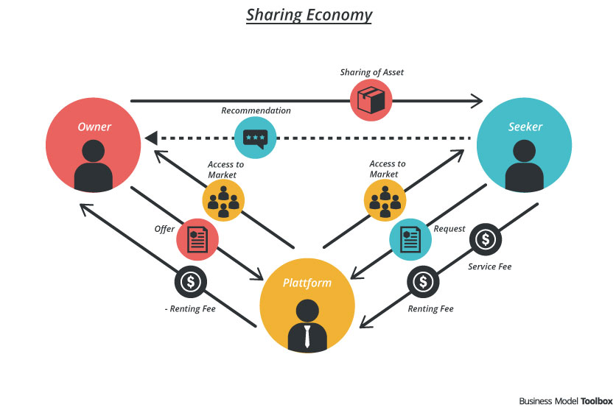
The Experience, Gift, Sharing Economy
Giving Trends
세상을
움직이는
경제
Experience
Economy
Share
Economy
Gift
Economy
Global
Philanthropy

Slide 15
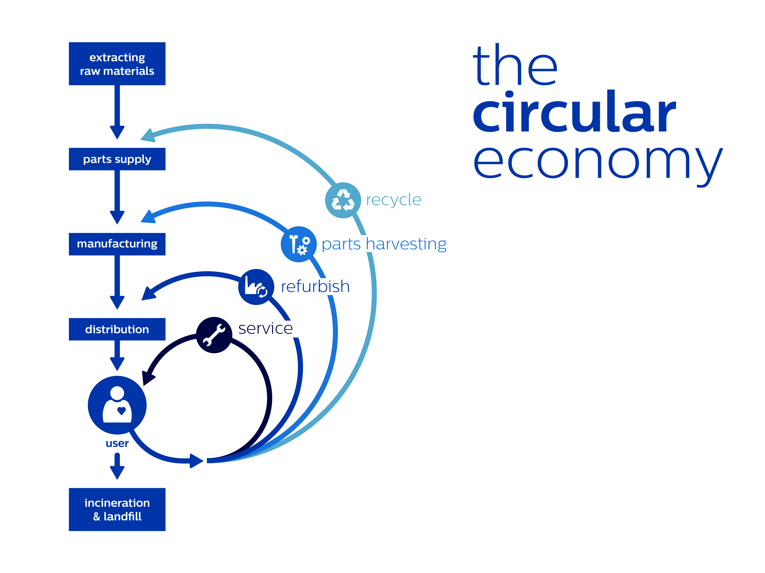
Token, Circular, Attention Economy
Giving Trends

Slide 16
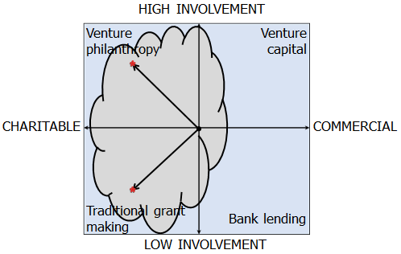
Social Finance Exists Across a Broad Continuum
Giving Trends

Slide 17
Donors are most likely to give if they know these things
There's a specific problem they can understand.
There's a specific and meaningful solution. Don't give them the impression that the problem is so big it can't be solved.
They can be a meaningful part of that solution. Make sure they know their giving level (whether it's $25 or a million bucks) does something great.

Slide 18
What We Are Trying To
Fundraising Strategy of Our Organization
Asian NPO
Golden Rule
Fundraising Capacity
of the Organization
Pressure Needle
Pyramid
Box

Slide 19
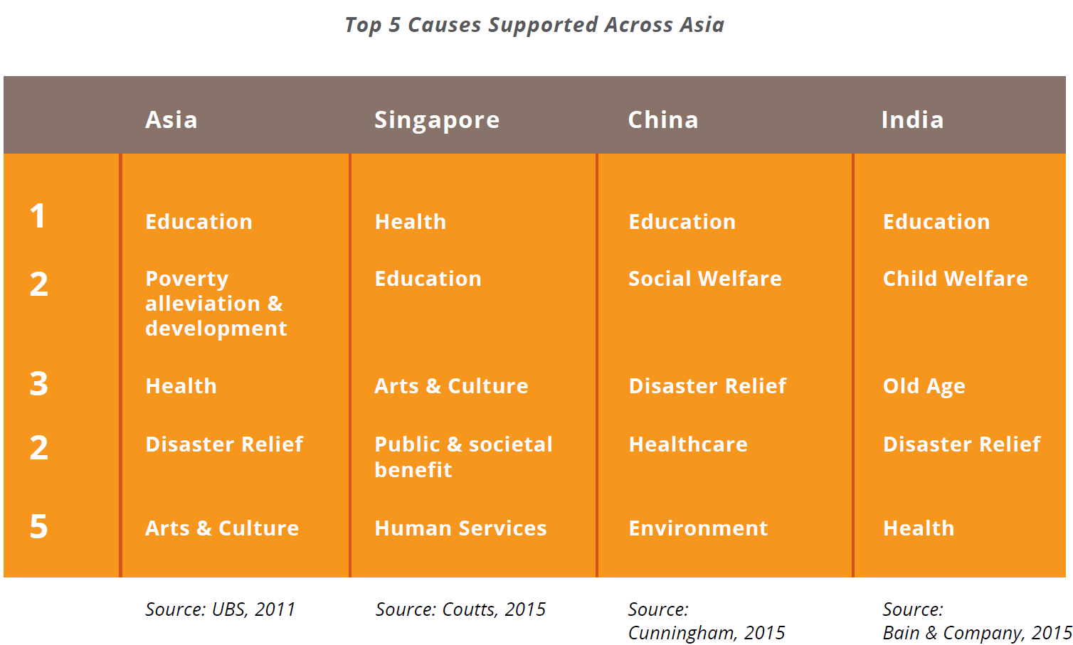
Giving Trends

Slide 20
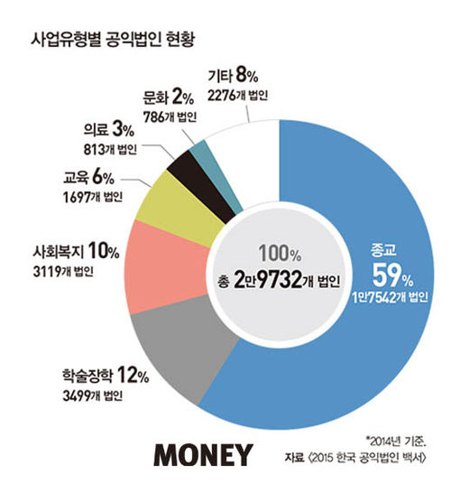
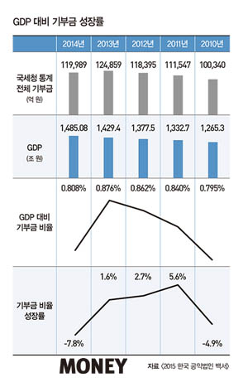
Korea Giving Trends
Giving Trends

Slide 21
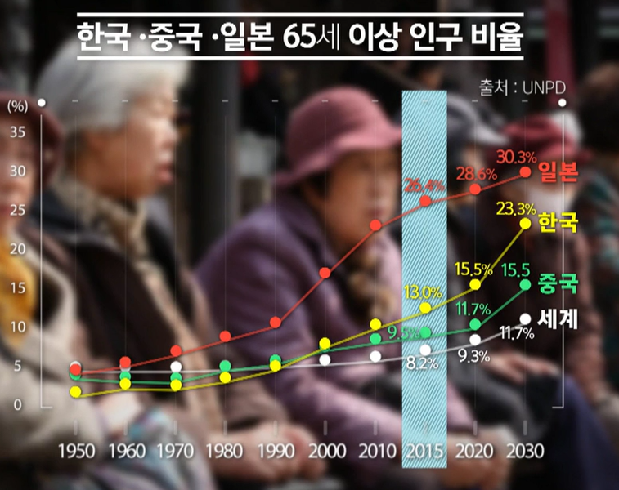
The Demographic Aging
Giving Trends
Japan
Korea
China
Global

Slide 22
Giving Trends in Korea
Future Giving and Planned Gift Intention of Korean Prospects
Source: 통계청 2015 사회조사 결과

Slide 23
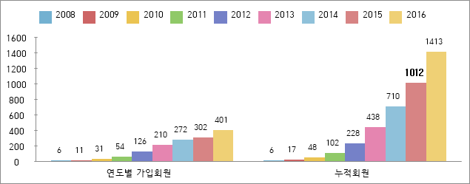
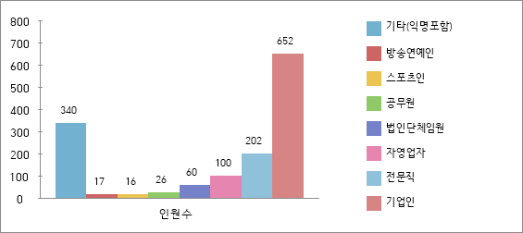
Giving Trends
Honor Society in Korea (2016년 12월 29일 기준)
☞ 아너 회원 수 : 1,413명 (익명회원 167명 포함) ☞ 누적약정금액 : 약 1,500억
 | 20대 | 30대 | 40대 | 50대 | 60대 | 70대 | 80대
인원 | 29 | 53 | 188 | 494 | 438 | 172 | 39
비율 | 2.1% | 3.8% | 13.3% | 34.9% | 31.0% | 12.2% | 2.8%

Slide 24
3 key Elements of Korean Giving Culture
Giving Trends
Gamification : competition, urgency, fun
Crowdfunding : Peer-to-Peer
Behavioral Economics
Small, not big
Hopeful, not Hopeless
Peer pressure still works
Notes:
Neoclassical economics

Slide 25
Innovation in Korea Fundraising
Giving Trends
Contactless Payments
Virtual Reality
Digital Currency
Social Media and Messaging Apps
Online Payment Functionality
Peer-to-Peer Fundraising
Delivering Donor-Centric Fundraising

Slide 26
Cross Culture Issues
Culture Difference
Relationship with Nature: Controlling Nature and Letting it
Relationship with Man: Power Distance
Social Position: Achieving vs. Ascribing Status
Perspective of Time: Sequential and Synchronic
Communication Style: High Context and Low Context

Slide 27
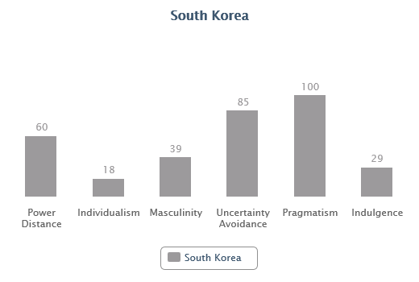
Culture Difference

Slide 28
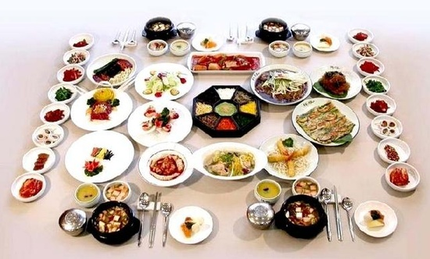
Dining Culture of Korea
Culture Difference
Notes:
서양의 모금방법이 동양에서 잘 적용이 싶지 않은 이유 중에 하나가 서로 다른 시간의 보는 관점의 차이이다. 인류문화학자인 에드워드 홀(Edward Hall)의 문화의 차이를 사간의 보는 시각의 차이로 서양의 sequential 과 synchronic 의 차이와 monochromic 과 polychromic 의 차이를 말한다. 하나씩 스케줄대로 하는 문화와 동시에 여러 개를 하는 차이는 모금캠페인에서도 확연히 차이가 난다. 서양의 모금방법은 스케줄대로 큰 금액부터 모금을 하고 점차적으로 작은 모금을 하는 순서에 따르지만 동양의 조직은 순서대로 하기보다 동시 다발로 원하기에 서양식 방법으로 모금플랜을 만들어도 진행이 어렵다. 마치 한국의 밥상문화가 한 상에 한꺼번에 반찬과 밥을 한꺼번에 먹은 "공간전개형"형태와 서양의 코스씩 밥상문화의" 시간전개형" 차이에서 온 것과 비슷하다.
서양의 모금방법이 동양에서 잘 적용이 싶지 않은 이유 중에 하나가 서로 다른 시간의 보는 관점의 차이이다. 인류문화학자인 에드워드 홀(Edward Hall)의 문화의 차이를 사간의 보는 시각의 차이로 서양의 sequential 과 synchronic 의 차이와 monochromic 과 polychromic 의 차이를 말한다. 하나씩 스케줄대로 하는 문화와 동시에 여러 개를 하는 차이는 모금캠페인에서도 확연히 차이가 난다. 서양의 모금방법은 스케줄대로 큰 금액부터 모금을 하고 점차적으로 작은 모금을 하는 순서에 따르지만 동양의 조직은 순서대로 하기보다 동시 다발로 원하기에 서양식 방법으로 모금플랜을 만들어도 진행이 어렵다. 마치 한국의 밥상문화가 한 상에 한꺼번에 반찬과 밥을 한꺼번에 먹은 "공간전개형"형태와 서양의 코스씩 밥상문화의" 시간전개형" 차이에서 온 것과 비슷하다.

Slide 29
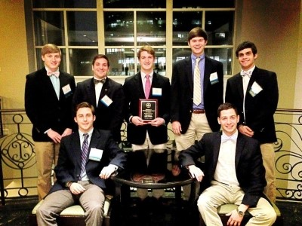
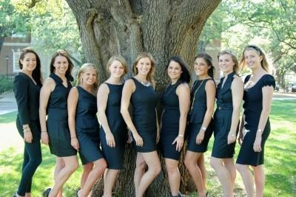
Western Style Fraternity Philanthropy in Campus?
Principles of Good Practice
University of South Carnolina Homepage
www.smu.edu/fsl/sororities
Notes:
four pillar ‘학문, 봉사, 리더쉽 그리고 우정’이다

Slide 30
The Comparison Between American and Korean Fundraising Practices
Culture Difference
American Practice (Gold Standard) | Korean Practice
Participate Actively Raising with Board (Recognized as the important role of the Board) | Participate Passively Raising with Board (The lack of need for Fundraising)
Direct Asking | Indirect Asking
Donation Requested Amount Determined | Donation Requested Amount Not Determined or Range
Case Statement | Lack of Case Statement
Profiling & Strategy | No Information
Relationship | Lack of Relationship
Emphasis on Accountability , including Reporting on the use Donations | Lack of Recognition Obligations, Reporting and Feedback

Slide 31
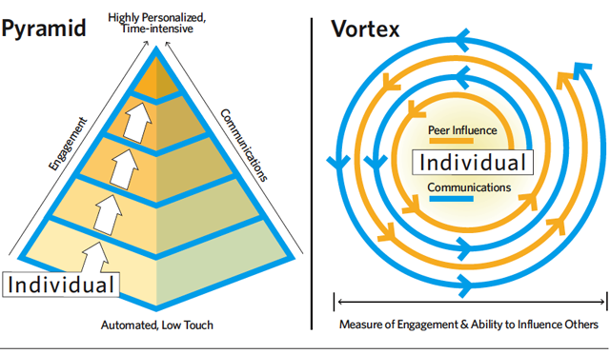
Donor Engagement Models
Paradigm Shift
http://ssir.org/articles/entry/the_permanent_disruption_of_social_media

Slide 32
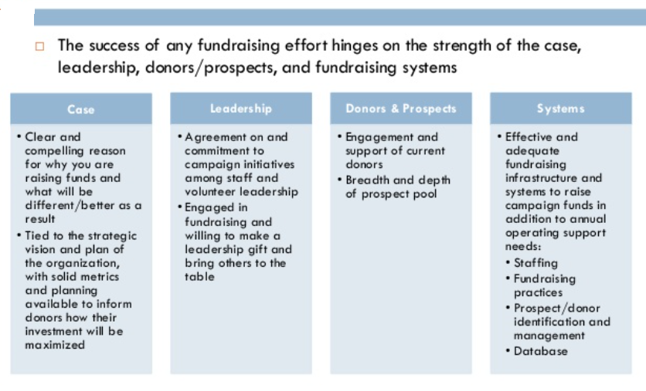
Four Pillars of Fundraising
Principles of Good Practice

Slide 33
3 Component of Philanthropy Education
Principle of Good Practice
Theory
Philanthropy
Research
Vocation
Industry
Practice
Character
Best
Practice
Body of
Knowledge
Leadership
Economy+ Finance
Partnership+

Slide 34
Fundraising Golden rule 1-2-3
Principles of Good Practice
First Gift
0-1>1-100
Second Gift
First penguin w/o second penguin. 49% of organizations never asked us for a second gift
Third Gift
The true value of data, perfect number, Giving pattern

Slide 35
Help donors overcome the four barriers that keep donors from giving:
What We Are Trying To
Fear of regret – the donor asks if they made the right decision.
The bystander effect – the donor assumes they don’t need to act because someone else will.
Efficacy – the donor questions whether their donation will even make a difference to the cause.
The paradox of choice – the donor doesn’t know how to choose a donation amount.

Slide 36
The Nine Eyes of Donor Development
What We Are Trying To
 | 9'I | 6'I | 5'I | 4'I | 2'I
Identify | ⚫ | ⚫ | ⚫ | ⚫
Investigate | ⚫
Invite | ⚫ | ⚫
Inform | ⚫ | ⚫ | ⚫
Interest | ⚫ | ⚫ | ⚫ | ⚫
Intervene | ⚫ |  |  |  | ⚫
Involve | ⚫ | ⚫ | ⚫ | ⚫
Invest | ⚫ | ⚫ | ⚫ | ⚫ | ⚫
Inspire | ⚫

Slide 37
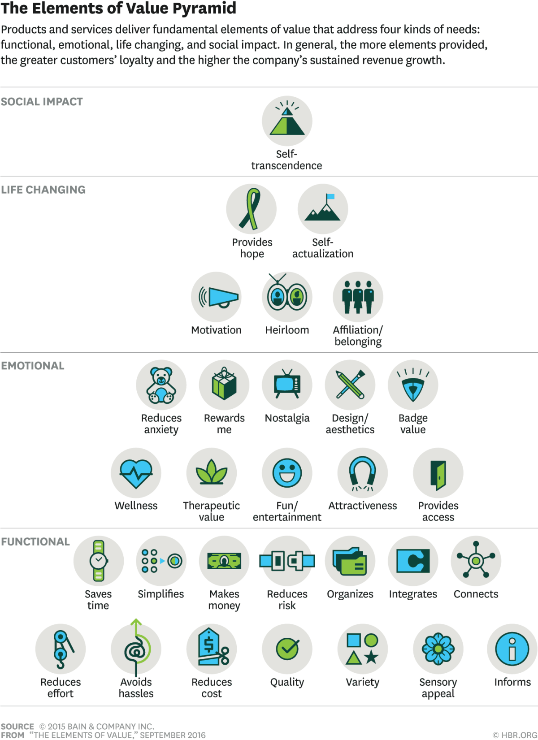
What We Are Trying To

Slide 38
What We Are Trying To
Fundraising 5 Direction
FR priority examples :
$
Reduce financial
vulnerability
Widen income mix/scores
Increase fund-raising efficiency
Grow number of donors/ average gift
Increase sustainable funding sources

Slide 39
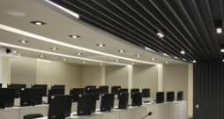
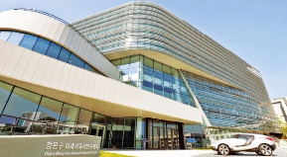
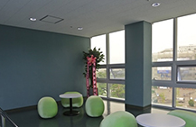
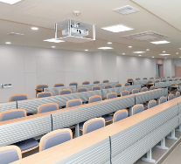
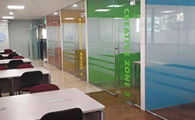
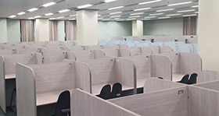
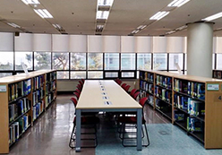
What We Are Trying To
Before They Leave Campus,
Get Them to Leave
Something Behind
Ex1. Donors Naming Business
Ex2. Student facilities

Slide 40
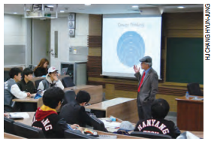
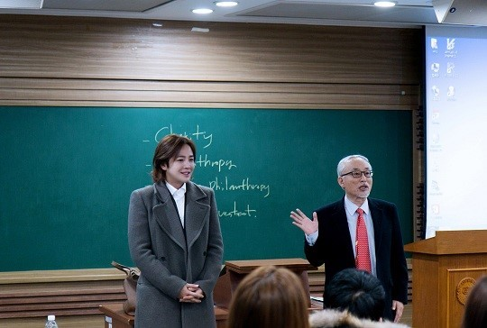
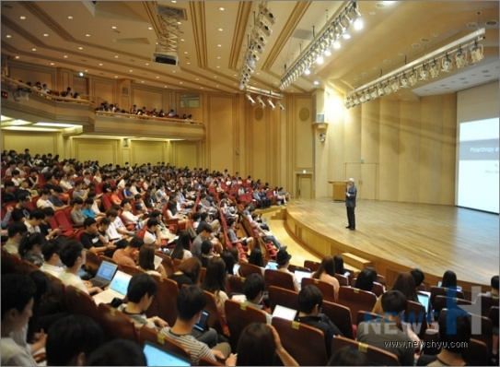
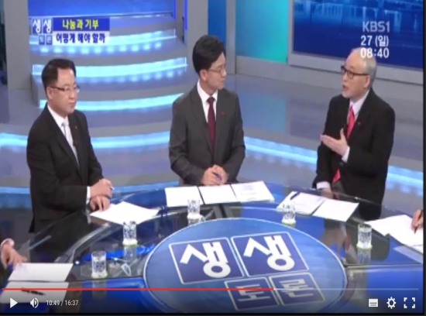
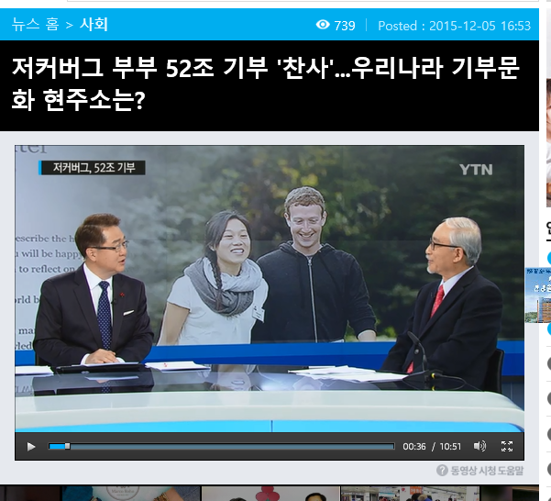
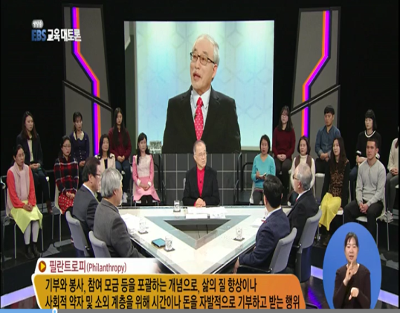
What We Are Trying To
Philanthropy and Fundraising

Slide 41
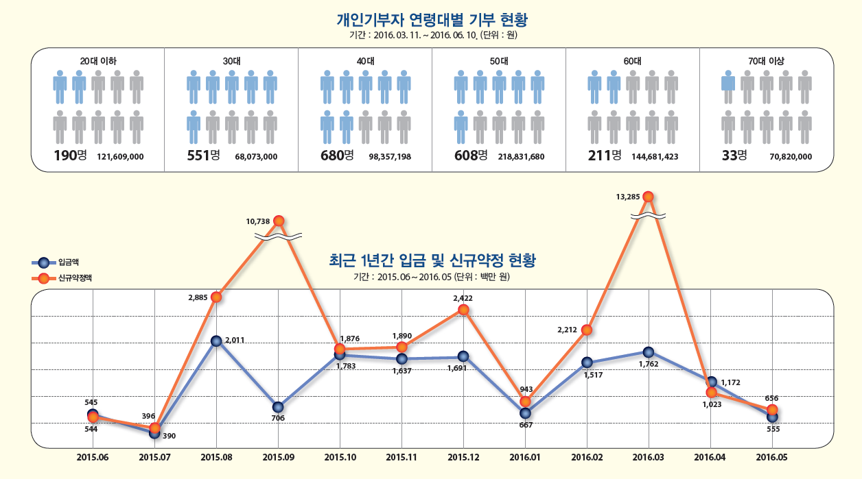
What We Are Trying To

Slide 42
What We Learned
Staff Compensation
Staff Size
Total Fundraising Expenses
Emphasis on Major Gifts Activity
Success Factors
Redefining Healthcare Philanthropy: Foreword By William McGinly

Slide 43
Major Gifts Officer?
What We Learned
The right qualities:
Enjoys talking with people
Makes it a priority to get out of the office
Is self-motivated, optimistic and inspired
Is organized
Likes to ask
Some guidelines as to
how much they can
reasonably be expected
to handle:
2-3 visits before an ask
50 – 70% close ratio
2 – 3 face-to-face solicitations/month
12 – 15 face-to-face visits/month

Slide 44
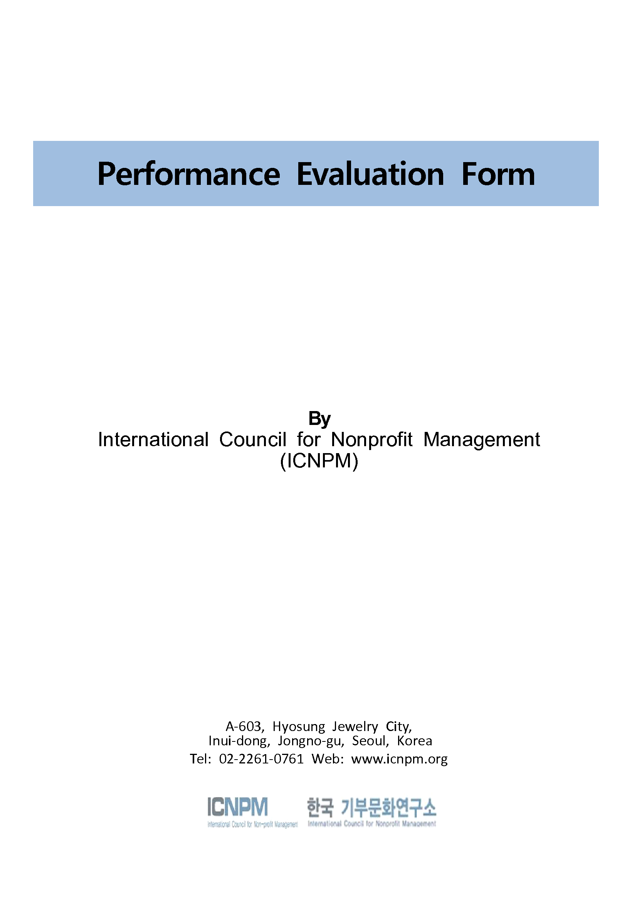
What We Learned

Slide 45
The Three Issue Before Innovation
Key Issue & Trend
Good Practice vs. Best practice
Value create vs. Value capture
Culture vs. Industry

Slide 46
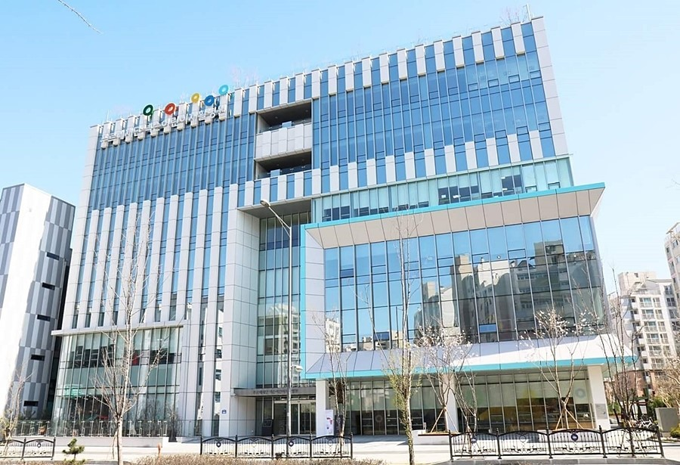
Capital Campaign Case Study
Case Study
Notes:
Purme’s Foundation built the first Children’s Rehabilitation Hospital for children with disabilities in Korea, after seeing that the country sorely lacked a facility that could cater to their needs. Sean has been supporting the foundation’s efforts for the hospital since it first started to flesh out in 2011, and officially opened in April 28, 2016..

Slide 47
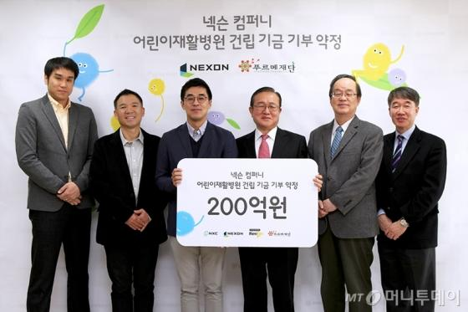
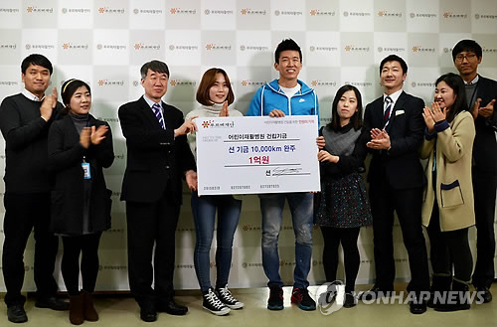
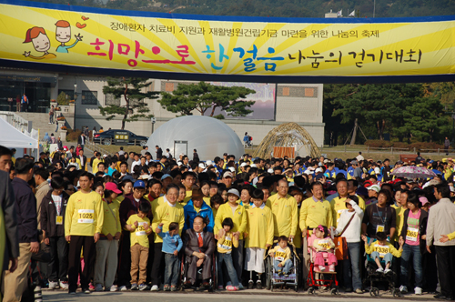
Case Study
Notes:
Purme’s Foundation built the first Children’s Rehabilitation Hospital for children with disabilities in Korea, after seeing that the country sorely lacked a facility that could cater to their needs. Sean has been supporting the foundation’s efforts for the hospital since it first started to flesh out in 2011, and officially opened in April 28, 2016..

Slide 48
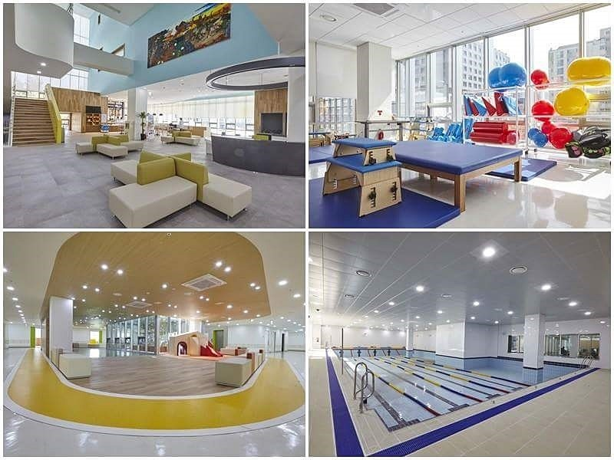
Case Study

Slide 49
Adapt Expectation Management
Case Study
Time
Scope
Quality
Cost
Expectation
Time
Cost
Quality
Scope

Slide 50
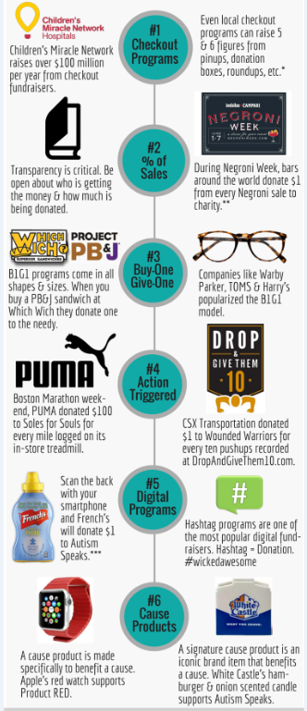
The Major Cause Marketing Fundraisers
Case Study
Checkout Programs
Percentage-of-Sales
Buy-One, Give-One
Digital Programs
Action-Triggered Donations
Cause Products

Slide 51
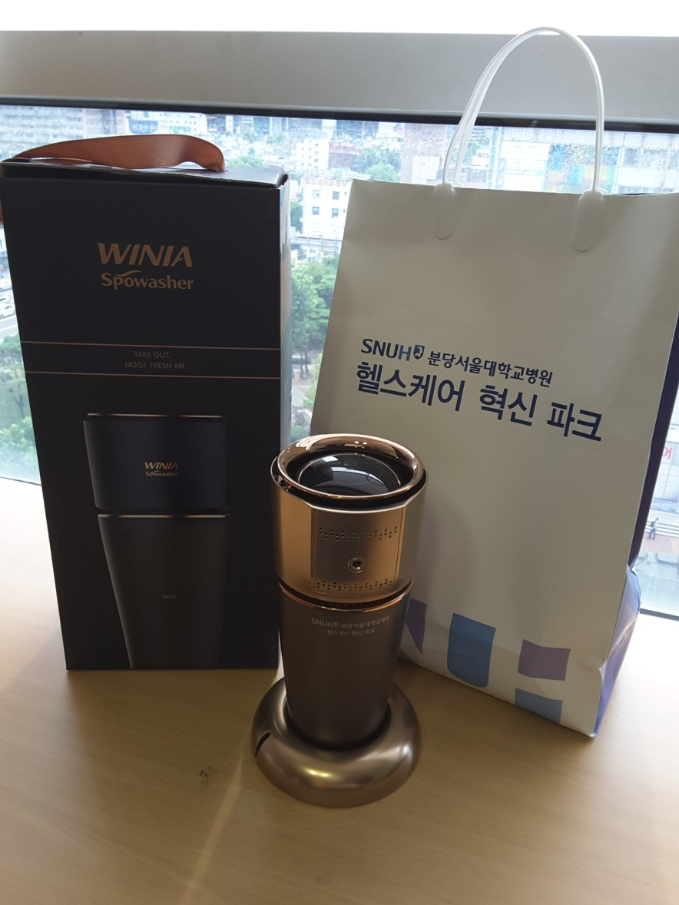
Case Study
Sample of Cause Products
(Seoul National University Hospital)

Slide 52
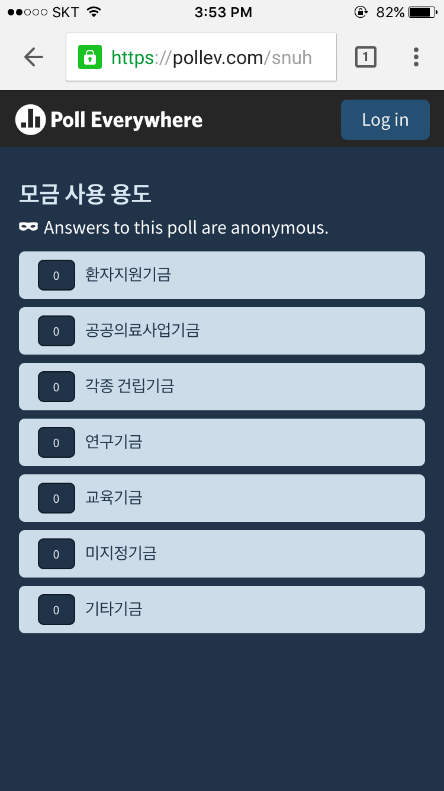
Instant survey - Pollev.com/snuh
Case Study
→

Slide 53
Giving Industry
From Culture To Industry

Slide 54
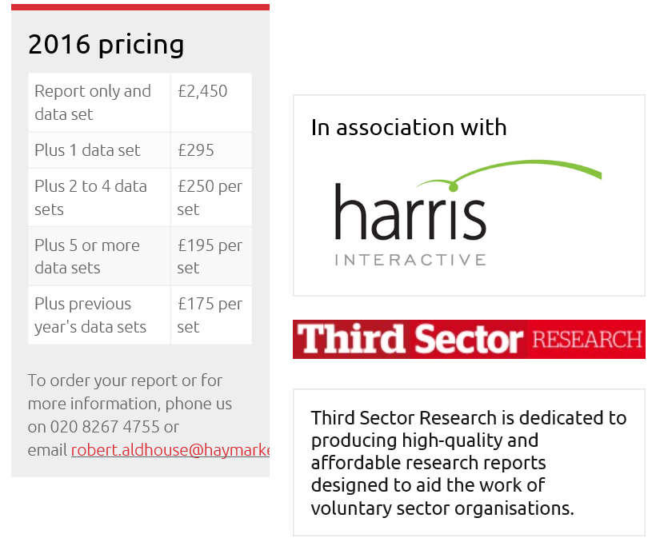
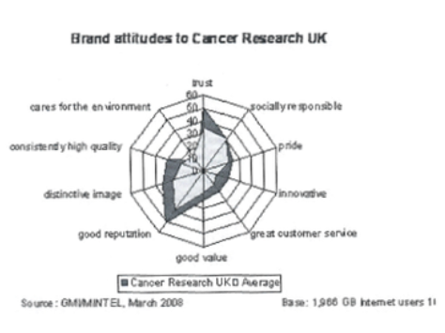
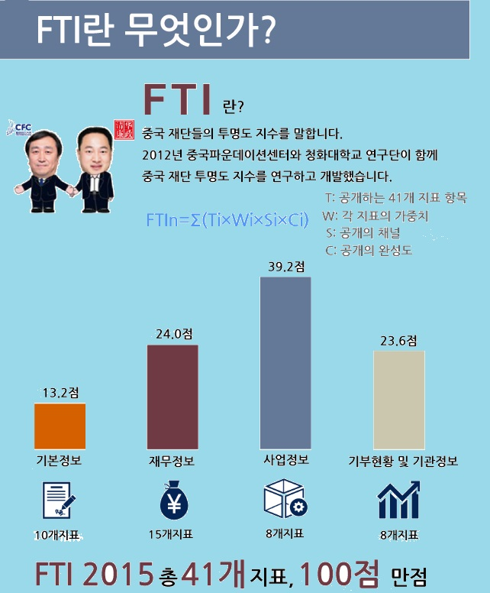
Index Industry
From Culture To Industry
Charity Brand Index
Made in China

Slide 55
Information Industry
From Culture To Industry
Australia
USA
USA

Slide 56
Thank You
Q&A

